Slide 1

Group K:
Emilio Gómez Esteban
Fernando Javier López Cerezo
Enrique Pérez Haro
Juan José Rodríguez Hernández
Genetic Algorithm Project

Slide 2

Index
Our Fitness Function
Genetic Sudoku Algorithm
Incomplete Work

Slide 3
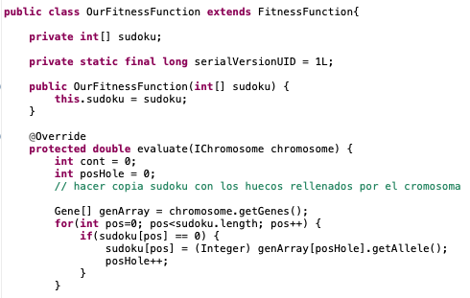
Our Fitness Function
Our class OurFitnessFunctions implements a method evaluate which evaluates a particular Sudoku instance.
First we fill the Sudoku’s holes using a chromosome .

Slide 4
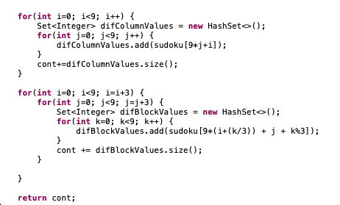
OurFitnessFunction
Then for each column we count the number of different elements.
We do the same for the blocks and add up all the different values from the columns and blocks.
This is the value returned by evaluate(). The higher the value returned by evaluate the more “fit” the Sudoku instance is. When it reaches the maximum the Sudoku is solved.

Slide 5
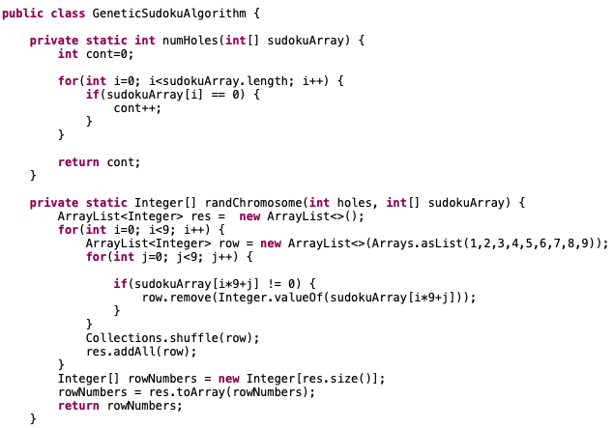
Genetic Sudoku Algorithm
Our class GeneticSudokuAlgorithm contains the main methods to solve the sudoku.
The method numHoles counts the holes in a given Sudoku.
The method randChromosome given an array with holes fills them randomly making sure that all elements in the same row are different.

Slide 6
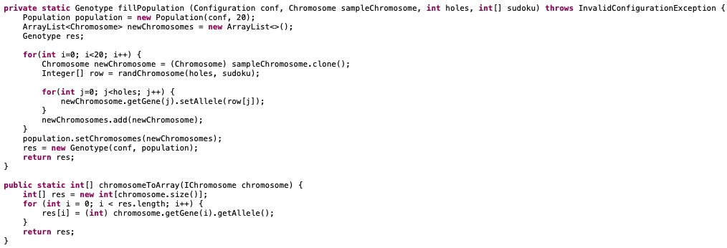
Genetic Sudoku Algorithm
The method fillPopulation generates 20 chromosomes using randChromosome and returns a Genotype variable with those chromosomes.
ChromosomeToArray simply returns an array with the values of a given chromosome.

Slide 7
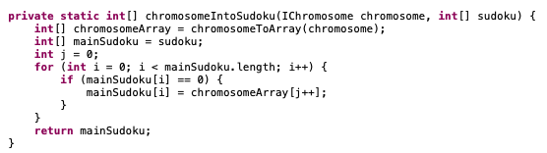
Genetic Sudoku Algorithm
This method uses the values given by a chromosome to fill the Sudoku.

Slide 8
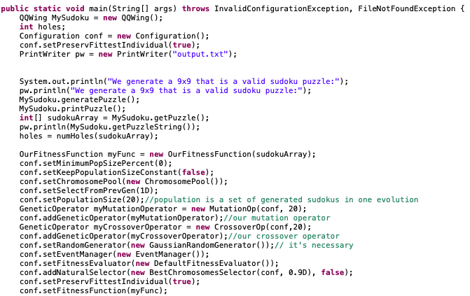
Genetic Sudoku Algorithm
We shall now explain our main method. Firstly we generate a Sudoku and show it in screen with the holes.
We count the number of holes, create our fitness function and initialise the configuration.

Slide 9
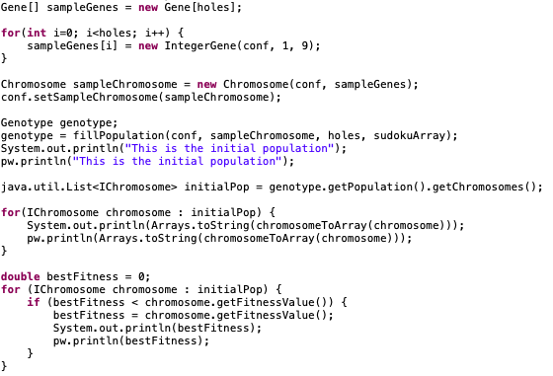
Genetic Sudoku Algorithm
We create an array of Genes using the holes of the Sudoku. Each Gene is an integer value between 1 and 9. We then create a Chromosome using this Genes.
We call the method fillPopulation to generate our population of 20 chromosomes and show it in screen.
We calculate which element of our population has the best fitness value, which we then show in screen.

Slide 10
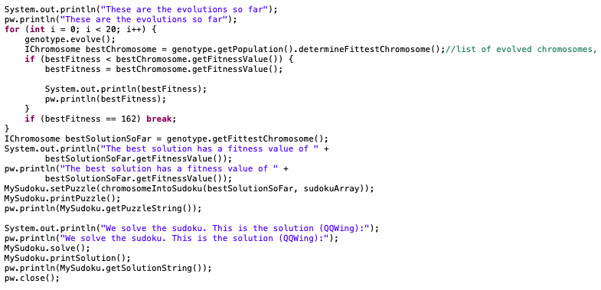
Genetic Sudoku Algorithm
Finally we use the Crossover and Mutation methods to generate Sudoku instances with increasingly better fitness values until we find a valid solution or we complete 20 epochs and reach the best possible generated instance.
The best solution is inserted into the Sudoku and then compared to the solution generated by QQWing.

Slide 11
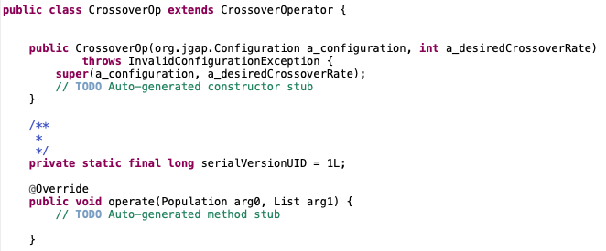
Incomplete Work
We were unable to implement the Crossover method.
This method would, given two chromosomes, divide them into two and combine them to generate a new chromosome.
Without this method our main method simply generate the initial population and is unable to find the solution or at least better Sudoku instance.

Slide 12
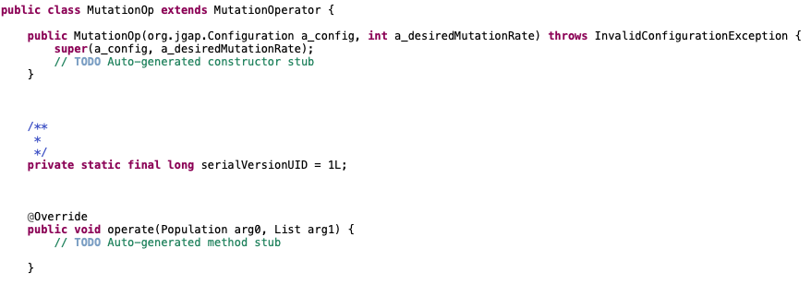
Incomplete Work
We were also unable to implement the Mutation method.
This method would have, given a chromosome, randomly modified one of its genes.

Slide 13
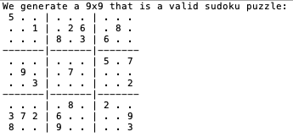
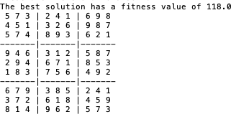
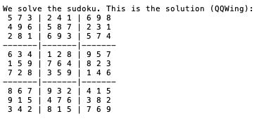
Output

